Slide 1
Machine Learning Techniques in Java
Ramesh Gundeti & Ferosh Jacob
Search and Personalization, The Home Depot

Slide 2
Agenda
Motivation
Introduction to machine learning
Generating Recommendations
Weka tutorial
Conclusion

Slide 3
Agenda
Motivation
Introduction to machine learning
Generating Recommendations
Weka tutorial
Conclusion

Slide 4


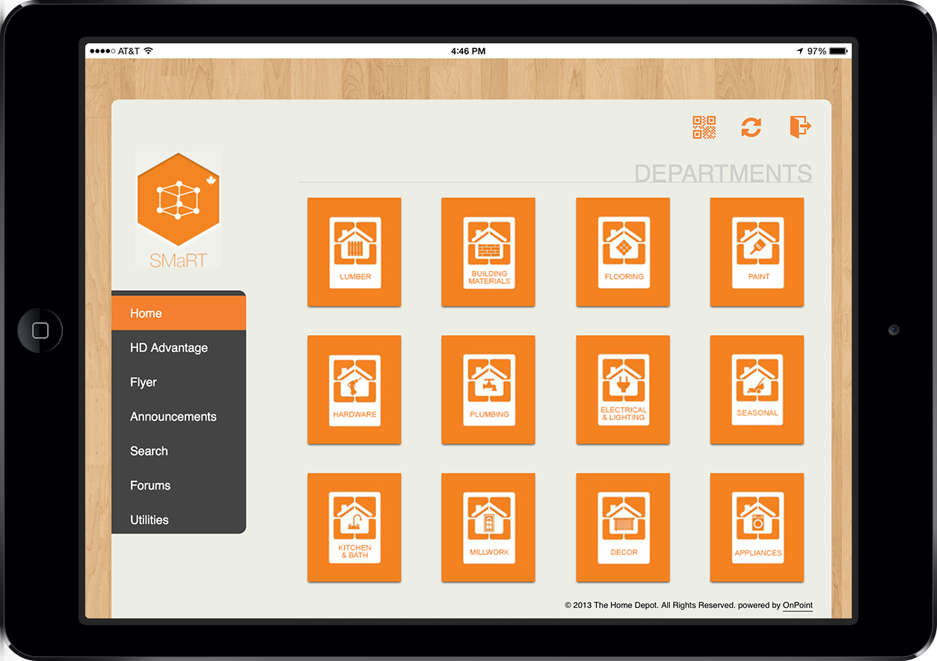
Motivation: TheHomeDepot.com

Slide 5
Motivation: TheHomeDepot.com
More than 4 Million sessions in a day
1 Billion searches last year
4K different types of products
Can you guess the most searched phrase last year?
toilet (1,177,157)
bathroom vanity (1,141,770)
refrigerator (1,128,169)

Slide 6
Agenda
Motivation
Introduction to machine learning
Generating Recommendations
Weka tutorial
Conclusion

Slide 7
Introduction to Machine learning
“Machine learning is a type of artificial intelligence (AI) that provides computers with the ability to learn without being explicitly programmed.” - Wikipedia
Types of machine learning
Supervised machine learning
Unsupervised machine learning

Slide 8
Introduction to Machine learning: Machine learning at home depot
Smart Sort in product listing page
Search results
Recommendations

Slide 9
Agenda
Motivation
Introduction to machine learning
Generating Recommendations
Weka tutorial
Conclusion

Slide 10
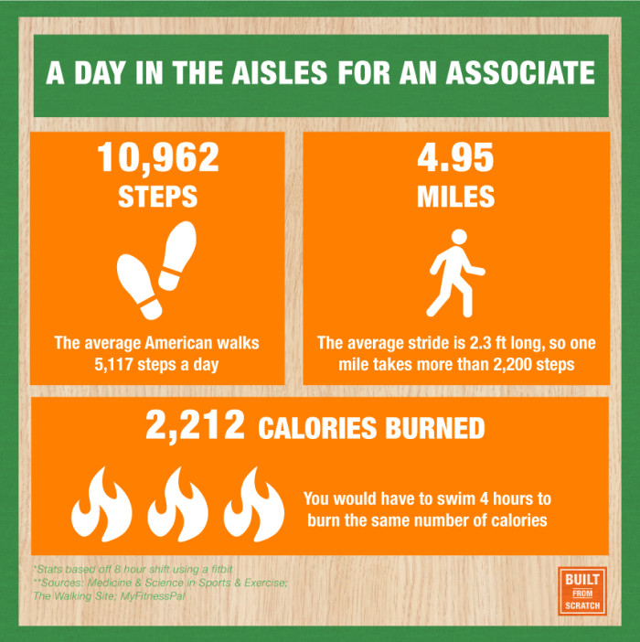
Generating Recommendations : HomeDepot.com Recommendations
There is no store associate on HD.com site
20% of HD.com revenue is generated through recommendations.

Slide 11
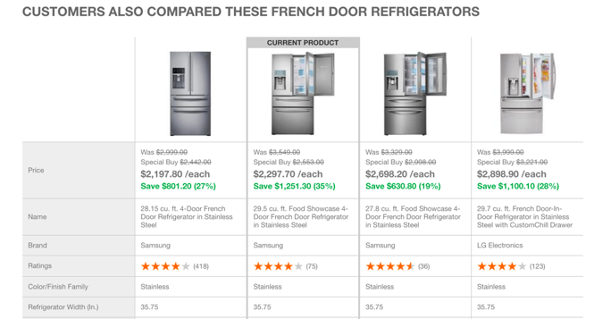
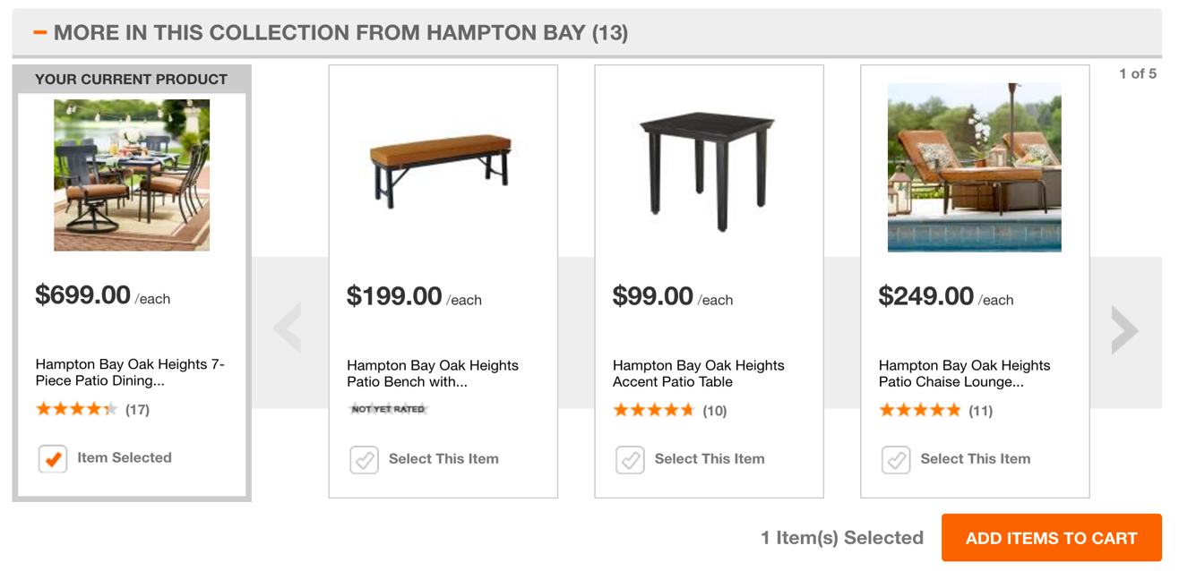
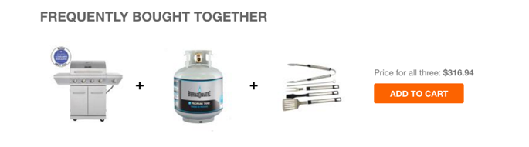
Generating Recommendations : HomeDepot.com Recommendations
Frequently bought together
Item related groups
Frequently compared

Slide 12
Generating Recommendations : Mahout Introduction
Mahout
Apache license
Java library
Also has implementation in Hadoop, Spark, H2O
Recommendations using Mahout
Data preparation
Training models
Evaluating/Testing

Slide 13
Generating Recommendations : Data preparation
“Garbage in – Garbage out”
Select data
Preprocess and format data
Clean up

Slide 14
Generating Recommendations : Frequent Pattern Growth
A pattern mining algorithm.
Takes in transactions.
p1,p2,p3
p1,p2,p4
p1,p5,p2
Generates frequent patterns.
p5 :: ([p1, p2, p5],1)
p4 :: ([p1, p2, p4],1)
p3 :: ([p1, p2, p3],1)
p2 :: ([p1, p2],3), ([p1, p2, p4],1), ([p1, p2, p5],1), ([p1, p2, p3],1)
p1 :: ([p1, p2],3), ([p1, p2, p4],1), ([p1, p2, p5],1), ([p1, p2, p3],1)

Slide 15
Generating Recommendations : Frequent Pattern Growth
Example

Slide 16
Generating Recommendations : Collaborative filtering
Item based recommendations
User based recommendations
Preferences data
Users (long userId)
Items (long itemId)
Preferences/Ratings (float preference)

Slide 17
Generating Recommendations : User-Item matrix
 | Item 1 | Item 2 | Item 3 | Item 4 | Item 5 | Item 6 | Item 7 | Similarity to User 1
User 1 | 5.0 | 3.0 | 2.5 | - | - | - | -
User 2 | 2.0 | 2.5 | 5.0 | 2.0 | - | - | -
User 3 | 2.5 | - | - | 4.0 | 4.5 | - | 5.0
User 4 | 5.0 | - | 3.0 | 4.5 | - | 4.0 | -
User 5 | 4.0 | 3.0 | 2.0 | 4.0 | 3.5 | 4.0 | -

Slide 18
Generating Recommendations : Similarity metrics
Pearson correlation-based similarity
n = number of pairs of scores
∑xy = sum of products of paired scores
∑x = sum of x scores
∑y = sum of y scores

Slide 19
Generating Recommendations : Similarity metrics
Tanimoto coefficient

Slide 20
Generating Recommendations : Similarity metrics
Log-likelihood-based Similarity
How strongly unlikely it is that two users have no resemblance in their preferences.
LLR = 2 sum(k) (H(k) - H(rowSums(k)) - H(colSums(k)))
H is Shannon's entropy

Slide 21
Generating Recommendations : Neighborhoods
Fixed-size neighborhoods
Nearest n users
Threshold based neighborhood
Similarity threshold

Slide 22
Generating recommendations: Demo
Example

Slide 23
Generating Recommendations : Evaluating recommendations
Average Absolute Difference
(0.5 + 0.5 + 0.5 + 1.0) / 4 = 0.625
Root Mean Square
⎷((0.5² + 0.5² + 0.5² + 1.0²)/4) = 0.4375
Precision
Fraction of retrieved products that are relevant.
Recall
Fraction of relevant products that are retrieved.
 | Item 1 | Item 2 | Item 3 | Item 4
Actual | 4.0 | 3.5 | 2.0 | 5.0
Estimate | 3.5 | 3.0 | 2.5 | 4.0
Difference | 0.5 | 0.5 | 0.5 | 1.0

Slide 24
Generating Recommendations : Evaluating recommendations demo
Example

Slide 25
WEKA Tutorial

Slide 27
Machine learning overview
Data vs Information
“The acquisition of knowledge is always of use to the intellect, because it may thus drive out useless things and retain the good. For nothing can be loved or hated unless it is first known.”

Slide 28
Machine learning overview: Contact lenses
Presbyopia is a condition associated with aging in which the eye exhibits a progressively
diminished ability to focus on near objects

Slide 29
Machine learning overview: Contact lenses

Slide 30
Machine learning overview: Contact lenses
if tearProductionRate == reduced
then recommendation == none
if age == young && astigmatic == no && tearProductionRate == normal
then recommendation == soft
if age == pre-presbyopic && astigmatic == no && tearProductionRate == normal
then recommendation == soft
if age == presbyopic && spectaclePrescription == myope && astigmatic == no
then recommendation == none
if spectaclePrescription == hypermetrope && astigmatic == no && tearProductionRate == normal
then recommendation == soft
if spectaclePrescription == myope && astigmatic == yes && tearProductionRate == normal
then recommendation == hard
if age young && astigmatic == yes && tearProductionRate == normal
then recommendation == hard
if age == pre-presbyopic && spectaclePrescription == hypermetrope && astigmatic == yes
then recommendation == none
if age == presbyopic && spectaclePrescription == hypermetrope && astigmatic == yes
then recommendation == none

Slide 31
WEKA Introduction
“The weka (also known as Maori hen or woodhen) (Gallirallus australis) is a flightless bird species of the rail family. It is endemic to New Zealand” -Wikipedia

Slide 32
WEKA Introduction
A collection of machine learning algorithms for data mining tasks.
Weka is open source software issued under the GNU General Public License.
The algorithms can either be applied
directly to a dataset
called from your own Java code.
Weka contains tools for
data pre-processing,
classification,
regression,
clustering,
association rules,
and visualization.

Slide 33
Overview: WORD SENSE DISAMBIGUATION using WEKA
Problem specification
Data preparation
Modeling using the WEKA GUI
Using the model from Java/SCALA code

Slide 34
1. Problem specification: Identify product senses of words
Words have different meanings in different contexts (E.g., "speaker" can be used in the context of an "electrical device" or in the context of a "presiding officer").
The goal is to identify whether a given word within a given context can be identified as a product sold in a retail/home improvement store (i.e."speaker" as an "electrical device” can be be found in a retail/home improvement store, but “speaker” as “presiding” officer” cannot).

Slide 35
1. Problem specification: Identify product senses of words
Example 1. Speaker
speaker – “an electrical device”
THIS IS A PRODUCT SENSE
speaker – “presiding officer”
THIS IS NOT A PRODUCT SENSE
Example 2. Hammer
hammer – “act of pounding (delivering repeated heavy blows); the sudden hammer of fists caught him off guard; the pounding of feet on the hallway”
THIS IS NOT A PRODUCT SENSE
hammer- “hand tool with a heavy rigid head and a handle; used to deliver an impulsive force by striking”
THIS IS A PRODUCT SENSE

Slide 36
Problem specification: Identify product senses of words
4958550 | light | the visual effect of illumination on objects or scenes as created in pictures; "he could paint the lightest light and the darkest dark"
8272926 | smoker | a party for men only (or one considered suitable for men only)
7023062 | book | a written version of a play or other dramatic composition; used in preparing for a performance
3464523 | grille | a framework of metal bars used as a partition or a grate; "he cooked hamburgers on the grill"
2937374 | cable | a television system that transmits over cables
3860335 | pipe | the flues and stops on a pipe organ
9984335 | scribe | someone employed to make written copies of documents and manuscripts
4316686 | steamer | a cooking utensil that can be used to cook food by steaming it
10090370 | shower | someone who organizes an exhibit for others to see
2884787 | bowl | a wooden ball (with flattened sides so that it rolls on a curved course) used in the game of lawn bowling
3688932 | locker | a fastener that locks or closes
3347207 | escutcheon | a flat protective covering (on a door or wall etc) to prevent soiling by dirty fingers
12808124 | christmas tree | Australian tree or shrub with red flowers; often used in Christmas decoration
7688535 | suet | hard fat around the kidneys and loins in beef and sheep
4504300 | tumbler | a movable obstruction in a lock that must be adjusted to a given position (as by a key) before the bolt can be thrown
3084637 | compass | drafting instrument used for drawing circles
4453410 | toilet | a room or building equipped with one or more toilets
3413354 | futon | mattress consisting of a pad of cotton batting that is used for sleeping on the floor or on a raised frame

Slide 37
Problem specification: Identify product senses of words
“CrowdFlower is a data enrichment, data mining and crowdsourcing company based in the Mission District of San Francisco, California. The company's software as a service platform allows users to access an online workforce of millions of people to clean, label and enrich data.” - Wikipedia

Slide 38
Overview: WORD SENSE DISAMBIGUATION using WEKA
Problem specification
Data preparation
Modeling using the WEKA GUI
Using the model from Java/SCALA code

Slide 39
Data preparation: ARFF file generation
What are ARFF files
An ARFF (Attribute-Relation File Format) file is an ASCII text file that describes a list of instances sharing a set of attributes.
ARFF files were developed by the Machine Learning Project at the Department of Computer Science of The University of Waikato for use with the Weka machine learning software

Slide 40
Data preparation: ARFF file generation
% 1. Title: Iris Plants Database
%
% 2. Sources:
% (a) Creator: R.A. Fisher
% (b) Donor: Michael Marshall (MARSHALL%PLU@io.arc.nasa.gov)
% (c) Date: July, 1988
%
@RELATION iris
@ATTRIBUTE sepallength NUMERIC
@ATTRIBUTE sepalwidth NUMERIC
@ATTRIBUTE petallength NUMERIC
@ATTRIBUTE petalwidth NUMERIC
@ATTRIBUTE class {Iris-setosa,Iris-versicolor,Iris-virginica}
Header section
Data section
@DATA
5.1,3.5,1.4,0.2,Iris-setosa
4.9,3.0,1.4,0.2,Iris-setosa
4.7,3.2,1.3,0.2,Iris-setosa
4.6,3.1,1.5,0.2,Iris-setosa

Slide 41
Data preparation: ARFF file generation
@relation ProductSense
@attribute text string
@attribute isValid {yes,no}
@data
'a party for men only (or one considered suitable for men only)',yes
'a written version of a play or other dramatic composition; used in preparing for a performance',no
'a framework of metal bars used as a partition or a grate; \"he cooked hamburgers on the grill\"',no
'a television system that transmits over cables',no
'the flues and stops on a pipe organ',yes
'someone employed to make written copies of documents and manuscripts',yes
'a cooking utensil that can be used to cook food by steaming it',no

Slide 42
Overview: WORD SENSE DISAMBIGUATION using WEKA
Problem specification
Data preparation
Modeling using the WEKA GUI
Using the model from Java/SCALA code

Slide 43
Modeling using the WEKA GUI: WEKA GUI in Action

Slide 44
Modeling using the WEKA GUI: Algorithm comparison
Algorithm | TP Rate | FP Rate | Precision | Recall | F-Measure | ROC Area
J48 | 0.698 | 0.34 | 0.695 | 0.698 | 0.696 | 0.721
Naiver Bayes | 0.721 | 0.299 | 0.722 | 0.721 | 0.721 | 0.776
Random Forest | 0.724 | 0.297 | 0.725 | 0.724 | 0.725 | 0.778
LibSVM | 0.601 | 0.601 | 0.361 | 0.601 | 0.451 | 0.5
Logisitic | 0.622 | 0.398 | 0.627 | 0.622 | 0.624 | 0.632

Slide 45
Overview: WORD SENSE DISAMBIGUATION using WEKA
Problem specification
Data preparation
Modeling using the WEKA GUI
Using the model from Java/SCALA code

Slide 46
Using the model from Java/SCALA code: Source code view
https://github.com/feroshjacob/AJUGDemos
http://localhost:8080

Slide 47
Agenda
Motivation
Introduction to machine learning
Generating Recommendations
Weka tutorial
Conclusion

Slide 48
Questions?

